Slide 1
Murach’s C# (8th Edition)
Chapter 14
How to work with inheritance

Slide 2
Objectives
Applied
Use any of the features of inheritance that are presented in this chapter as you develop the classes for your apps.
Knowledge
Explain how inheritance is used within the .NET classes and how you can use it in your own classes.
Explain why you might want to override the ToString(), Equals(), and GetHashCode() methods of the Object class as you develop the code for a new class.
Describe the use of the protected and virtual access modifiers for the members of a class.
Describe the use of polymorphism.
Describe the use of the Type class.

Slide 3
Objectives (continued)
Describe the use of explicit casting when working with the objects of a base class and its derived classes.
Distinguish between an abstract class and a sealed class.

Slide 4
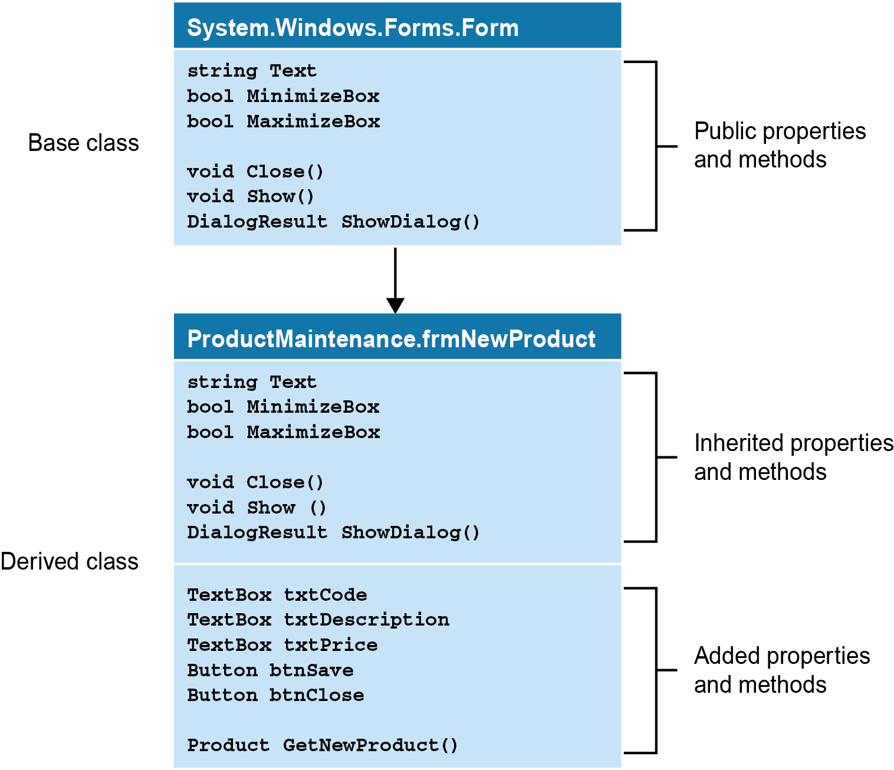
A diagram that shows how inheritance works

Slide 5
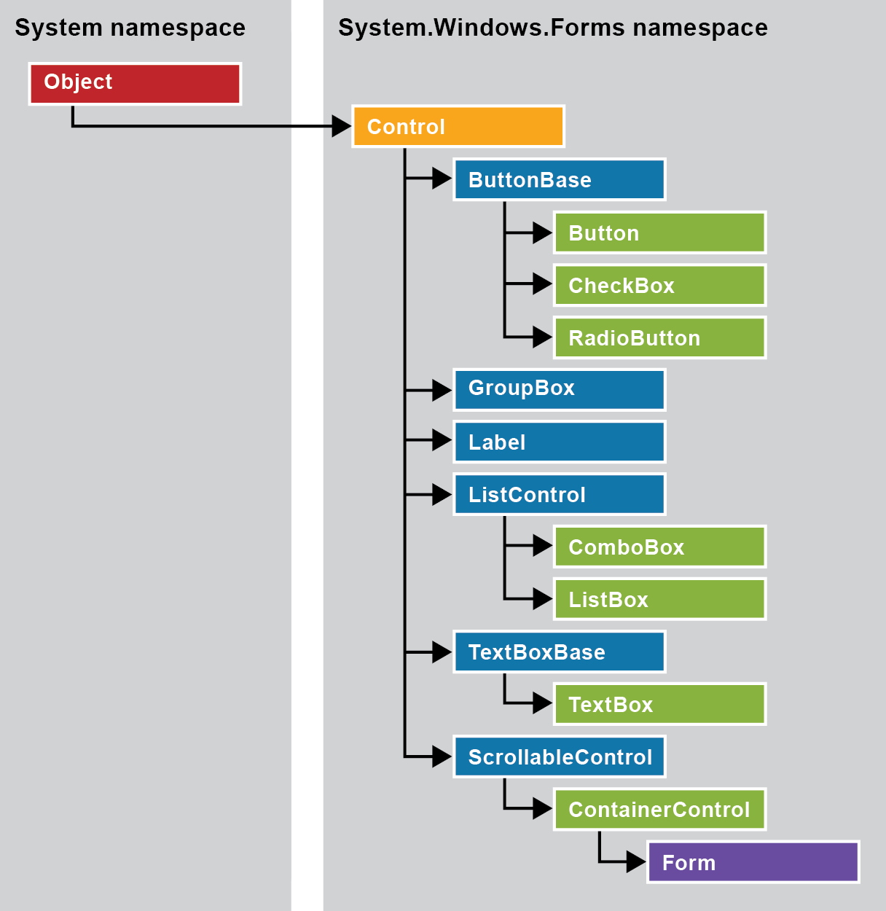
The inheritance hierarchy for form control classes

Slide 6
Methods of the System.Object class
ToString()
Equals(object)
Equals(object1, object2)
ReferenceEquals(object1, object2)
GetType()
GetHashCode()
Finalize()
MemberwiseClone()

Slide 7
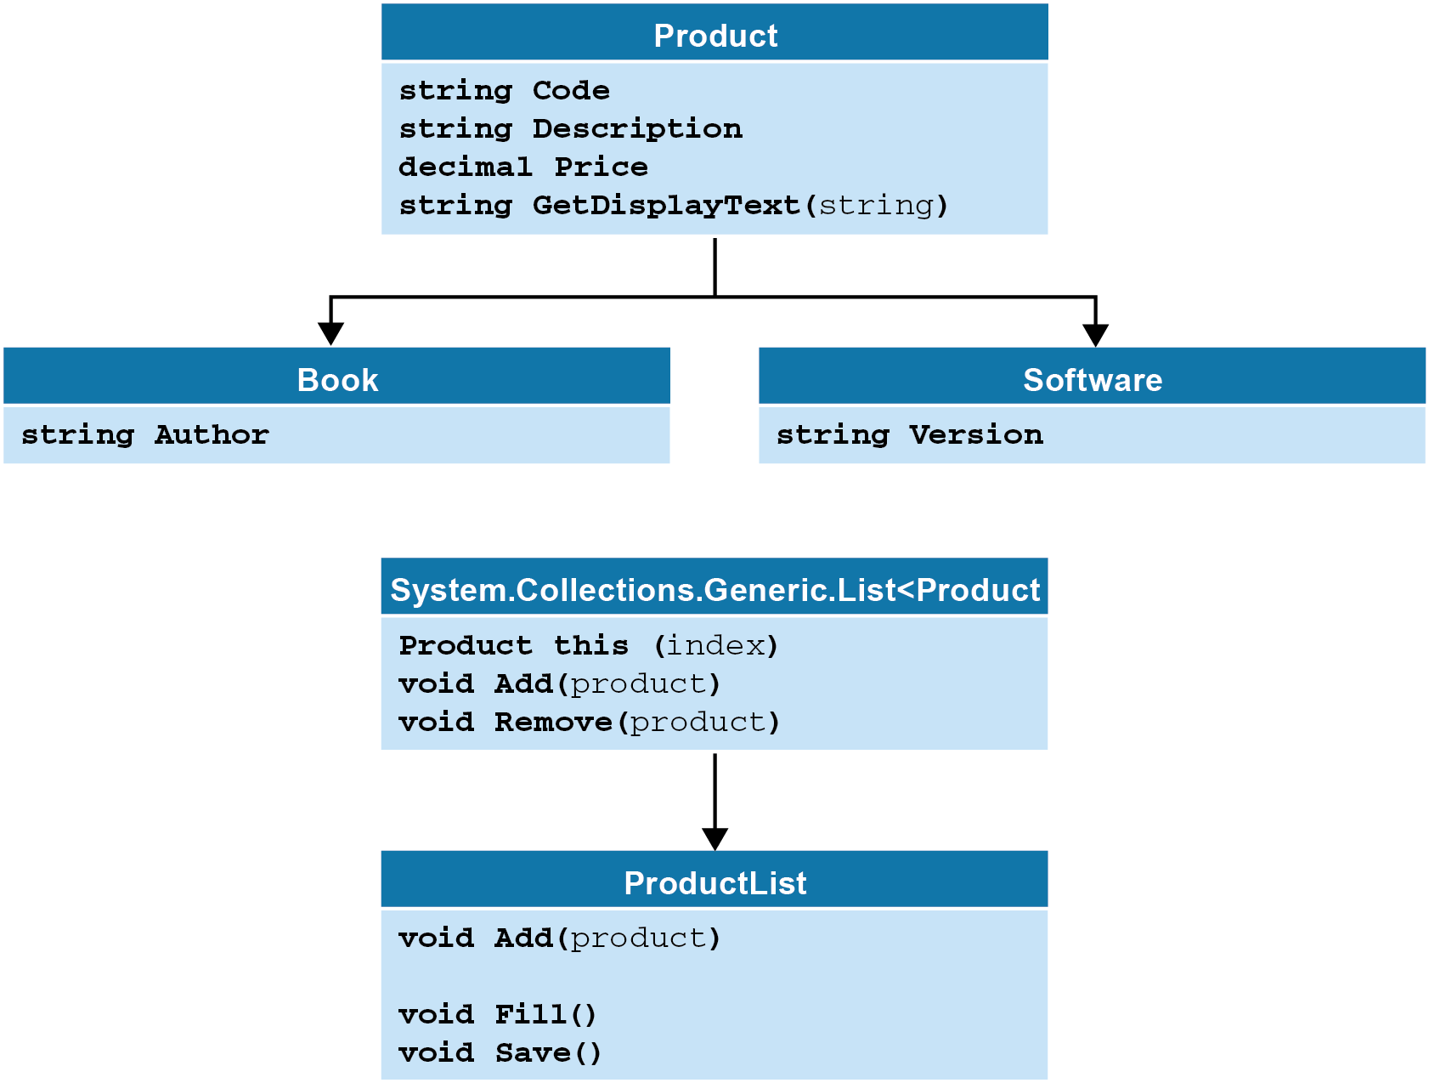
Business classes for a Product Maintenance app

Slide 8
The code for the Product base class
public class Product
{
public Product(string code, string description,
decimal price) =>
(this.Code, this.Description, this.Price) =
(code, description, price);
public string Code { get; set; } = "";
public string Description { get; set; } = "";
public decimal Price { get; set; }
public virtual string GetDisplayText(string sep) =>
$"{Code}{sep}{Price.ToString("c")}{sep}{Description}";
}

Slide 9
Keywords for access modifiers
public
protected
internal
protected internal
private protected
private

Slide 10
The code for a Book class
public class Book : Product
{
public string Author { get; set; } = "";
// A new property
public Book(string code, string description,
decimal price,string author) : base(code,
description, price)
{
this.Author = author;
// Initializes the Author field after
// the base class constructor is called.
}
public override string GetDisplayText(string sep) =>
$"{Code}{sep}{Description}{sep}{Price.ToString("c")}
({Author})";
}

Slide 11
Another way to override a method
public override string GetDisplayText(string sep) =>
$"{base.GetDisplayText(sep)} ({Author})";

Slide 12
Three versions of the GetDisplayText() method
A virtual GetDisplayText() method in the Product base class
public virtual string GetDisplayText(string sep) =>
$"{Code}{sep}{Price.ToString("c")}{sep}{Description}";
An overridden GetDisplayText() method in the Book class
public override string GetDisplayText(string sep) =>
$"{base.GetDisplayText(sep)} ({Author})";
An overridden GetDisplayText() method in the Software class
public override string GetDisplayText(string sep) =>
$"{base.GetDisplayText(sep)}, Version {Version}";

Slide 13
Code that uses the overridden methods
Book b = new("C#", "Murach's C#", 59.50m, "Anne Boehm");
Software s = new("NPTK", ".NET Programmer's Toolkit",
179.99m, "4.5");
Product p;
p = b;
MessageBox.Show(p.GetDisplayText("\n"));
// Calls Book.GetDisplayText()
p = s;
MessageBox.Show(p.GetDisplayText("\n"));
// Calls Software.GetDisplayText()

Slide 14
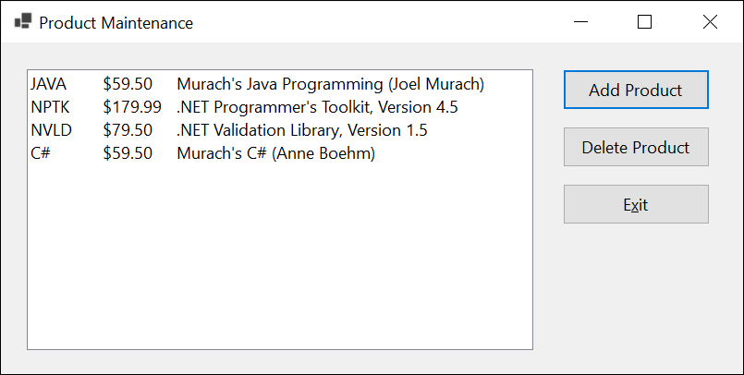
The Product Maintenance form

Slide 15
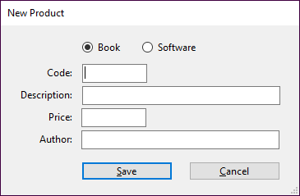
The New Product form

Slide 16
The code for the Product class
public class Product
{
public Product() { }
public Product(string code, string description,
decimal price) =>
(Code, Description, Price) = (code, description,
price);
public string Code { get; set; } = "";
public string Description { get; set; } = "";
public decimal Price { get; set; }
public virtual string GetDisplayText(string sep) =>
$"{Code}{sep}{Price.ToString("c")}{sep}{Description}";
}

Slide 17
The code for the Book class
public class Book : Product
{
public Book() { }
public Book(string code, string description,
decimal price, string author) :
base(code, description, price) => Author = author;
public string Author { get; set; } = "";
public override string GetDisplayText(string sep) =>
$"{base.GetDisplayText(sep)} ({Author})";
}

Slide 18
The code for the Software class
public class Software : Product
{
public Software() { }
public Software(string code, string description,
decimal price, string version) :
base(code, description, price) =>
Version = version;
public string Version { get; set; } = "";
public override string GetDisplayText(string sep) =>
$"{base.GetDisplayText(sep)}, Version {Version}";
}

Slide 19
The code for the ProductList class
public class ProductList : List<Product>
{
// Modify the behavior of the Add method
// of the List<Product> class
public new void Add(Product p) => base.Insert(0, p);
// Provide two additional methods
public void Fill()
{
List<Product> products = ProductDB.GetProducts();
foreach (Product product in products)
base.Add(product);
}
public void Save() => ProductDB.SaveProducts(this);
}

Slide 20
The code for the Product Maintenance form (part 1)
public partial class frmProductMain : Form
{
public frmProductMain()
{
InitializeComponent();
}
private ProductList products = new();
private void frmProductMain_Load(
object sender, EventArgs e)
{
products.Fill();
FillProductListBox();
}

Slide 21
The Product Maintenance form (part 2)
private void FillProductListBox()
{
lstProducts.Items.Clear();
foreach (Product p in products)
lstProducts.Items.Add(p.GetDisplayText("\t"));
}
private void btnAdd_Click(object sender, EventArgs e)
{
frmNewProduct newForm = new();
Product product = newForm.GetNewProduct();
if (product != null)
{
products.Add(product);
products.Save();
FillProductListBox();
}
}

Slide 22
The Product Maintenance form (part 3)
private void btnDelete_Click(
object sender, EventArgs e)
{
int i = lstProducts.SelectedIndex;
if (i != -1)
{
Product product = products[i];
string message =
"Are you sure you want to delete "
+ product.Description + "?";
DialogResult button =
MessageBox.Show(message, "Confirm Delete",
MessageBoxButtons.YesNo);
if (button == DialogResult.Yes)
{ products.Remove(product);
products.Save();
FillProductListBox();
}
}
}

Slide 23
The Product Maintenance form (part 4)
private void btnExit_Click(object sender, EventArgs e)
{
this.Close();
}
}

Slide 24
The code for the New Product form (part 1)
public partial class frmNewProduct : Form
{
...
private Product product = null!;
public Product GetNewProduct()
{
this.ShowDialog();
return product;
}
private void rbBook_CheckedChanged(
object sender, EventArgs e)
{
if (rbBook.Checked)
lblAuthorOrVersion.Text = "Author: ";
else
lblAuthorOrVersion.Text = "Version: ";
txtCode.Focus();
}

Slide 25
The code for the New Product form (part 2)
private void btnSave_Click(object sender, EventArgs e)
{
if (IsValidData())
{
if (rbBook.Checked)
product = new Book(txtCode.Text,
txtDescription.Text,
Convert.ToDecimal(txtPrice.Text),
txtAuthorOrVersion.Text);
else
product = new Software(txtCode.Text,
txtDescription.Text,
Convert.ToDecimal(txtPrice.Text),
txtAuthorOrVersion.Text);
this.Close();
}
}

Slide 26
The code for the New Product form (part 3)
private bool IsValidData()
{
bool success = true;
string errorMessage = "";
errorMessage += Validator.IsPresent(txtCode.Text,
nameof(Product.Code));
errorMessage +=
Validator.IsPresent(txtDescription.Text,
nameof(Product.Description));
errorMessage += Validator.IsDecimal(txtPrice.Text,
nameof(Product.Price));
if (rbBook.Checked)
errorMessage +=
Validator.IsPresent(txtAuthorOrVersion.Text,
nameof(Book.Author));
else
errorMessage +=
Validator.IsPresent(txtAuthorOrVersion.Text,
nameof(Software.Version));

Slide 27
The code for the New Product form (part 4)
if (errorMessage != "")
{
success = false;
MessageBox.Show(errorMessage, "Entry Error");
}
return success;
}
...
}

Slide 28
Code that uses the Type class to get information about an object
Product product = new Book("C#", "Murach's C#", 59.50m,
"Anne Boehm");
Type t = product.GetType();
Console.WriteLine("Name: " + t.Name);
Console.WriteLine("Namespace: " + t.Namespace);
Console.WriteLine("FullName: " + t.FullName);
Console.WriteLine("BaseType: " + t.BaseType.Name);
The result that’s displayed on the console
Name: Book
Namespace: ProductMaintenance
FullName: ProductMaintenance.Book
BaseType: Product

Slide 29
How to test an object’s type
Using the GetType() method
if (product.GetType() == typeof(Book)) {
// need to cast product object to type Book
}
Using pattern matching (C# 7.0 and later)
if (product is Book b) {
// no cast needed to work with Book object b
}

Slide 30
Two methods that display product information
public void DisplayProduct(Product p) =>
MessageBox.Show(p.GetDisplayText());
public void DisplayBook(Book b) =>
MessageBox.Show(b.GetDisplayText());

Slide 31
Code that doesn’t require casting
Book b = new Book(
"C#", "Murach's C#", 59.50m, "Anne Boehm");
DisplayProduct(b);
// Casting is not required because
// Book is a subclass of Product.

Slide 32
Code that requires casting
Product p = new Book("C#", "Murach's C#", 59.50m,
"Anne Boehm");
DisplayBook((Book)p);
// Casting is required because Product
// is the base class for Book.

Slide 33
Code that throws a casting exception
Product p = new Software("NPTK", ".NET Programmer's Toolkit", 179.99m, "4.5");
DisplayBook((Book)p);
// Will throw a casting exception because p is a Software // object, not a Book object.

Slide 34
Code that uses the as operator
Product p =
new Book("C#", "Murach's C#", 59.50m, "Anne Boehm");
DisplaySoftware(p as Software);
// Passes null because p isn't a Software object

Slide 35
An abstract Product class
public abstract class Product
{
public string Code { get; set; } = "";
public string Description { get; set; } = "";
public decimal Price { get; set; }
public abstract bool IsValid
{
get; // No body is coded for the getter
}
public abstract string GetDisplayText(string sep);
// No method body is coded.
}

Slide 36
A class that inherits the abstract Product class
public class Book : Product
{
public string Author { get; set; } = "";
public override bool IsValid =>
!String.IsNullOrEmpty(Code) &&
!String.IsNullOrEmpty(Description) &&
Price > 0 &&
!String.IsNullOrEmpty(Author);
public override string GetDisplayText(string sep) =>
$"{Code}{sep}{Description}({Author}){sep}
{Price.ToString("c")}";
}

Slide 37
The class declaration for a sealed Book class
public sealed class Book : Product

Slide 38
How sealed methods work
A base class named A that declares a virtual method
public class A {
public virtual void ShowMessage() =>
MessageBox.Show("Hello from class A");
}
A class named B that inherits class A and overrides and seals its method
public class B : A {
public sealed override void ShowMessage() =>
MessageBox.Show("Hello from class B");
}

Slide 39
How sealed methods work (continued)
A class named C that inherits class B and tries to override its sealed method
public class C : B {
public override void ShowMessage() => // Not allowed
MessageBox.Show("Hello from class C");
}

